Slide 1
Massachusetts Climate Careers: Powering the Future
Harnessing the Power of the Sun for Our Communities

Slide 2
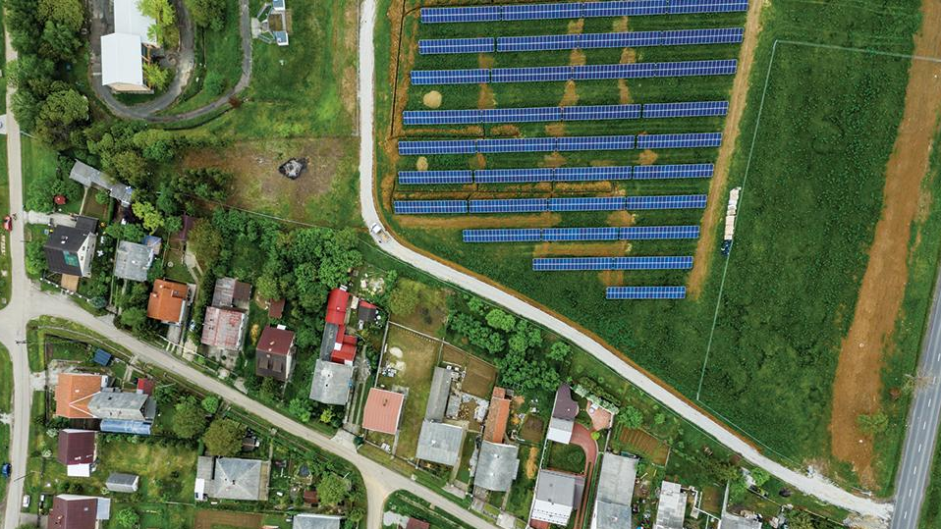
Community Solar allows people to share the benefits of solar energy—including lower emissions and reduced energy costs—without individual systems.
Notes:
We’ve covered several ways to improve energy efficiency and lower carbon emissions.
Today, we’ll explore how communities can work together to harness the sun's power through solar energy projects.
You’ll even get to try your hand at designing solar projects for different types of communities.

Slide 3
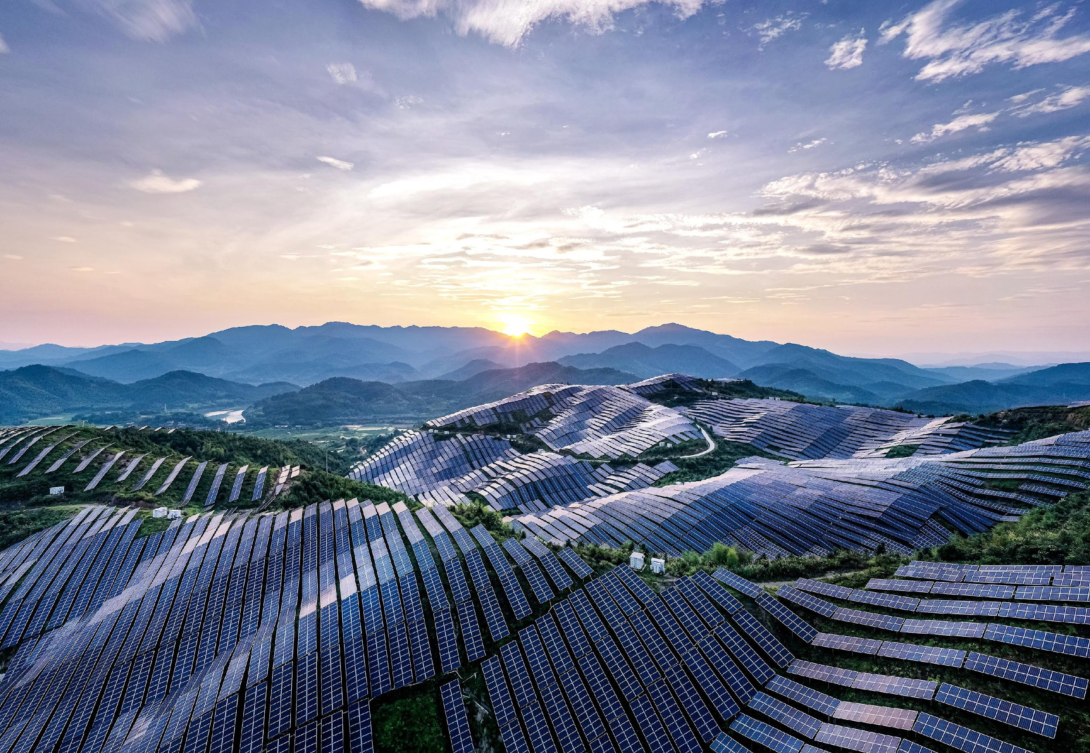
Opening Activity
Lesson 5: Harnessing the Power of the Sun for Our Communities
Notes:
Activity objective: Get students to evaluate what they already know about solar projects, and be ready to challenge and expand how they’ve seen solar power used in their communities.
Instructions:
Read the statements below one at a time. Invite students to raise their hands if they believe the statements are True. For a more physical version of the activity, designate areas of the room for “True” and “False” and ask students to move from one area to the other depending on their answer. After students declare their choices, ask one or two students to share their reasoning. Then, reveal the answer. This is not a quiz and should not be graded or scored, though it will give you a sense of what students already know and believe about solar energy.
True/False statements:
Solar panels convert sunlight directly into electricity.
True. Solar panels use photovoltaic cells to convert sunlight into electrical energy.
Solar panels can only generate electricity on sunny days.
False. Solar panels can generate electricity on cloudy days, although they are more efficient in direct sunlight.
Solar power only makes a noticeable impact on carbon emissions in places with a lot of sunlight, like deserts.
False. Solar energy can be beneficial in many climates, including places that experience colder or cloudy weather.
Community solar projects are only available to businesses and large facilities, not individual households.
False. Community solar projects can be designed to benefit businesses and individual households.
Community solar projects allow people to benefit from solar energy without having solar panels on their property.
True. Community solar lets people share the energy produced by a central solar facility.
You have to own a home to participate in a community solar project.
False. Renters and those who don’t own homes can participate in community solar projects.
Solar panels are silent and don’t produce any noise pollution.
True. Solar panels generate electricity quietly, making them an excellent option for urban and residential areas.
Solar power contributes to air and water pollution.
False. Solar power does not produce air or water pollution.
Solar energy can be stored in batteries for use when the sun isn’t shining.
True. Solar energy can be stored in batteries for later use, such as at night or on cloudy days.
The cost of solar energy has decreased significantly in the last decade.
True. The cost of solar energy has dropped significantly due to technological advances and increased production.

Slide 4
The Big Question and My Climate Goals
Climate Watch and Discussion
The Power of Community Solar
Pitching Community Solar
Takeaways and Closing
Lesson 5: Harnessing the Power of the Sun for Our Communities
4

Slide 5
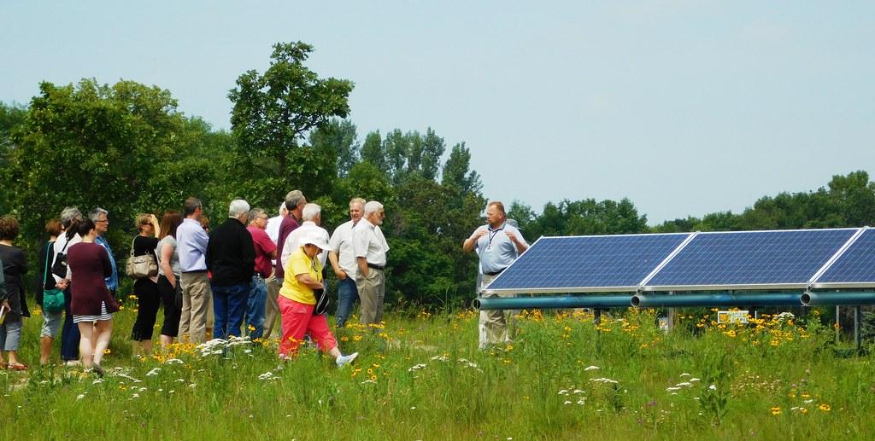
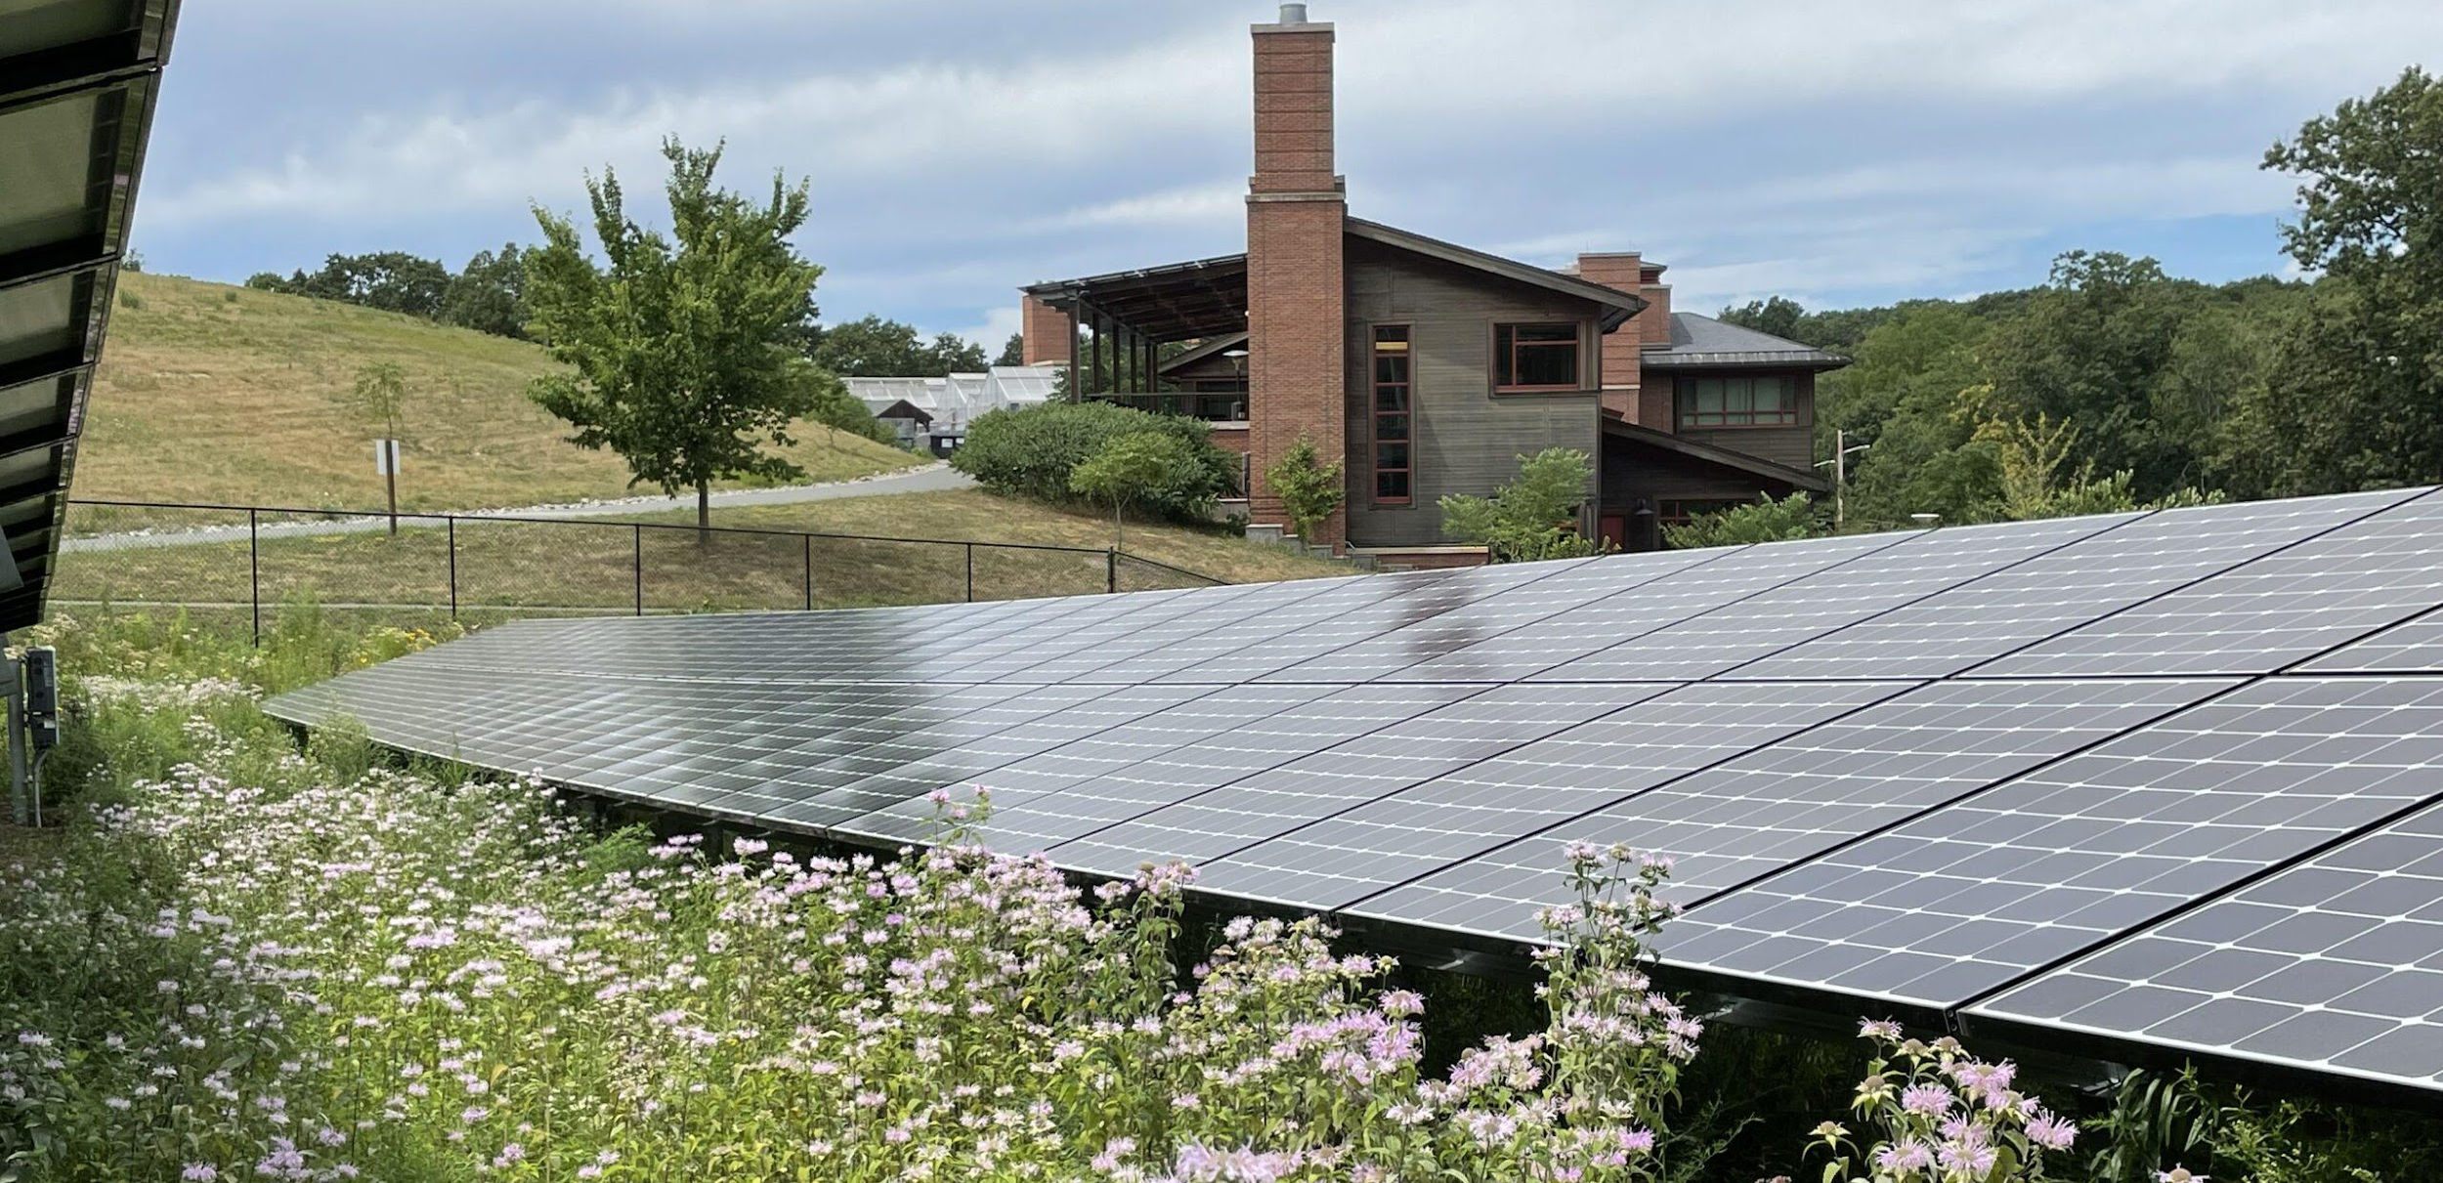
What is community solar, and what are its benefits?
The Big Question
Brewster Community Solar Garden
Serves over 200 households and has generated over 3 million kWh of clean energy since 2016.
Harvard Community Solar Garden
Powers municipal buildings and residences, reducing local greenhouse gas emissions by 1,500 tons annually.
Courtesy XXXXXX
Lesson 5: Harnessing the Power of the Sun for Our Communities
5
Notes:
Massachusetts is a leader in community solar, with over 1,500 megawatts (MW) installed as of 2023. Here are two community solar success stories.
These and other community solar projects save customers money and contribute significantly to Massachusetts’s clean energy goals!

Slide 6
My Climate Goals
When you complete this lesson, you’ll be able to
Explore examples of community solar projects in Massachusetts
Identify some examples of climate-critical professionals who work together to make community solar projects succeed, from the design to the outreach to the installation and maintenance phases
Discuss how individual solar and community solar projects can support various individual and community needs.
6

Slide 7
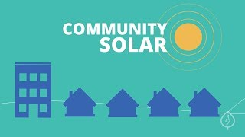
The Power of Community Solar
Courtesy Energy Sage
Lesson 5: Harnessing the Power of the Sun for Our Communities
Notes:
A community solar project is a solar energy project that benefits multiple people in one community.
Instead of each person or business having their own solar panels, a community shares the energy from one big solar installation
Play this short video showing an example of how community solar can work for many residential communities
Source: https://www.youtube.com/watch?v=TS_lP49e63s

Slide 8
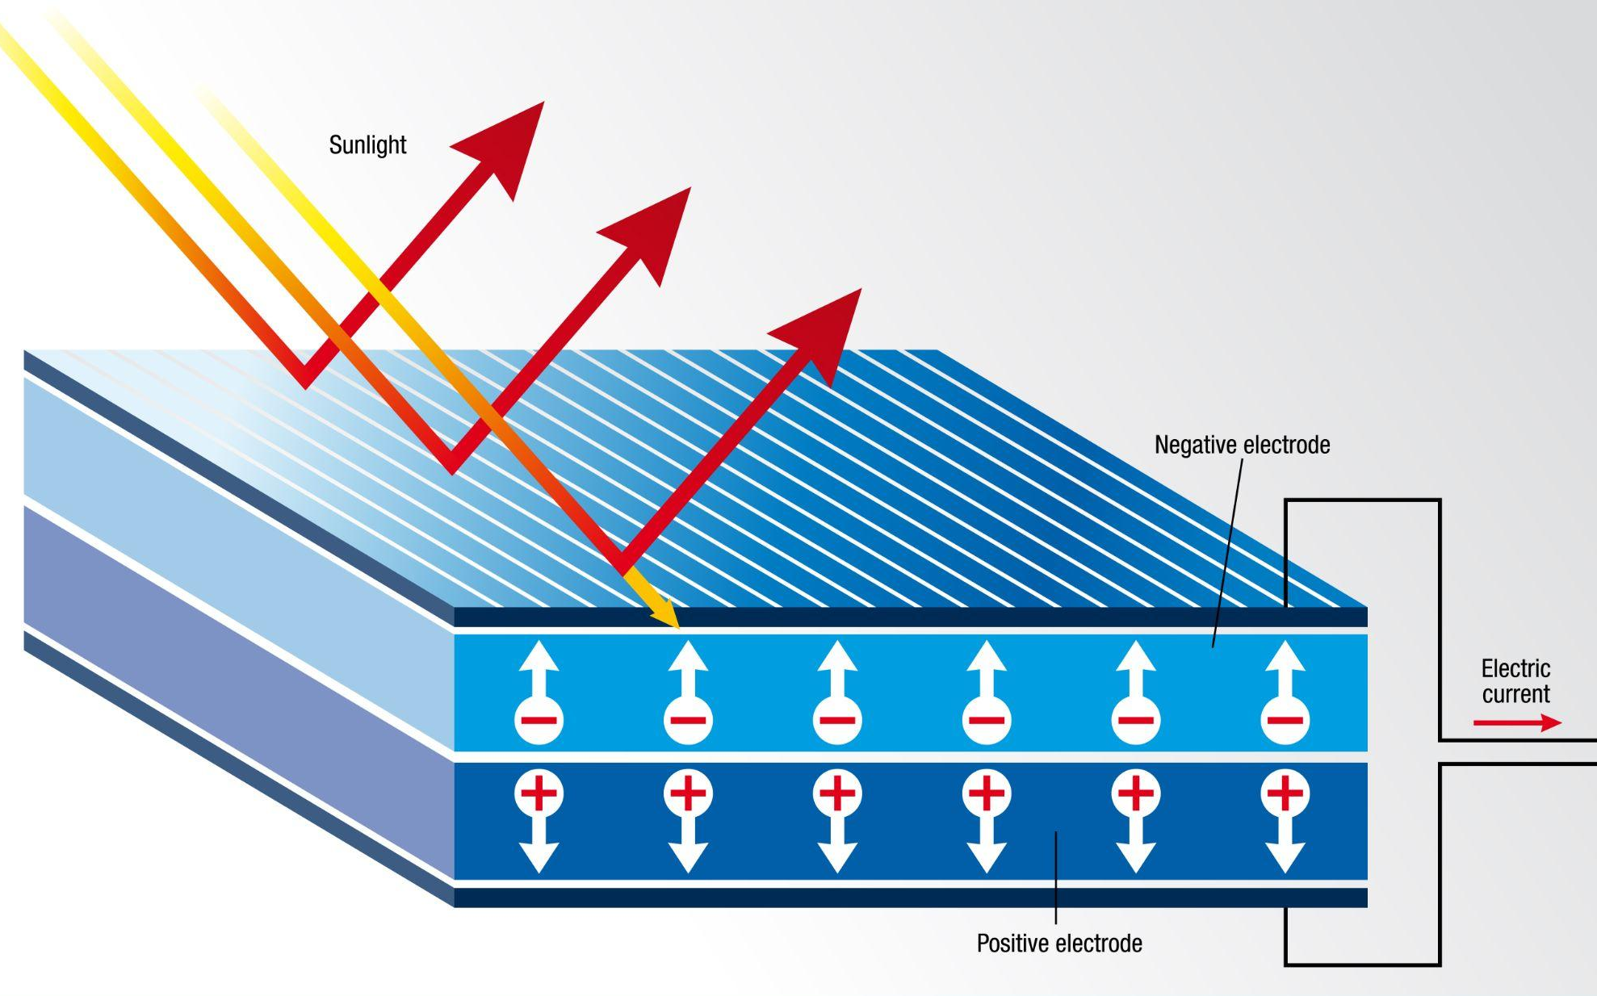
Introduction to Solar
Solar energy is power generated from the sun.
Solar panels capture sunlight and turn it into electricity.
This electricity is used to power homes, schools, and more.
Lesson 5: Harnessing the Power of the Sun for Our Communities
8
Notes:
Call on one or two students to share what they already know about solar energy.
Review the diagram to explain the basics of photovoltaic (solar) panels.

Slide 9
Solar panels are made of solar cells.
When sunlight hits the cells, photons knock electrons loose.
Free electrons flow through the cells, creating an electric current.
The current is collected by wires and used as electricity.
How Solar Panels Work
Lesson 5: Harnessing the Power of the Sun for Our Communities
9
Notes:
Solar panels are made of solar cells, typically made from silicon.
When sunlight hits the cells, particles of light called photons knock electrons loose.
These free electrons flow through the cell, creating an electric current.
The current is collected by wires and used as electricity to power homes, devices, and anything else that runs on electricity!
Solar panels have no moving parts, making them durable and long-lasting.

Slide 10
Community Solar Technology
1
3
6
2
4
5
Community solar projects rely on large-scale solar-electric systems that can power dozens or even hundreds of homes and businesses. Look at the illustration of the main components of these systems.
Lesson 5: Harnessing the Power of the Sun for Our Communities
10
Notes:
Review the main components of these community solar systems using the labeled illustration:
Solar panels convert sunlight into electricity, harnessing renewable energy to power homes and businesses.
Solar batteries store energy generated by solar panels, providing power during nighttime or cloudy days and enhancing energy independence.
Inverters convert direct current (DC) from solar panels into alternating current (AC), making the energy usable for homes and businesses.
Transformers adjust electrical voltage levels, stepping them up or down as needed for safe transmission and efficient power distribution.
Metering and switchgear keep electrical systems safe and allow technicians to monitor the operation of community solar systems.
Utility grids are networks that distribute electricity from producers to consumers, ensuring a consistent power supply across various locations.

Slide 11
The Benefits of Solar
Clean and renewable energy
Reduction of pollution and carbon emissions
Potential savings over time
Ability to store power in a battery for later use
Flexible arrangements and designs
Lesson 5: Harnessing the Power of the Sun for Our Communities
11

Slide 12
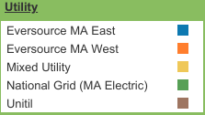
Energy Equity
Why might some communities have more access to solar energy than others?
All planned and operational community solar projects in Massachusetts as of July 15, 2022
Utilities:
Map and data provided by Massachusetts Clean Energy Center.
Lesson 5: Harnessing the Power of the Sun for Our Communities
12
Notes:
Invite one or two students to respond to this question: Why do some communities have more access to solar energy than others?
Answers: pollution, site access, resources to build the solar farm, community support
Community solar projects can help people and areas who can’t install their own solar panels, including anyone who rents a home or doesn’t have space for their own solar panels
Community solar projects can help make solar energy more accessible for everyone, contributing to energy equity.
Energy equity is a form of environmental justice that describes equal access to resources like clean energy.

Slide 13
Climate Watch: Video
Lesson 5: Harnessing the Power of the Sun for Our Communities
Notes:
MassCEC video coming by Spring 2025.
[This video features a young woman who works at Nexamp, an installer of community solar projects.]

Slide 14
Share what you learned from the video and listen to your classmates’ perspectives. Here are a few thoughts to get you rolling:
What does Evaleah like about her career?
How would you describe what “community solar” is?
Climate Watch Discussion
Lesson 12: Climate Hero Spotlight: Engineers

Slide 15
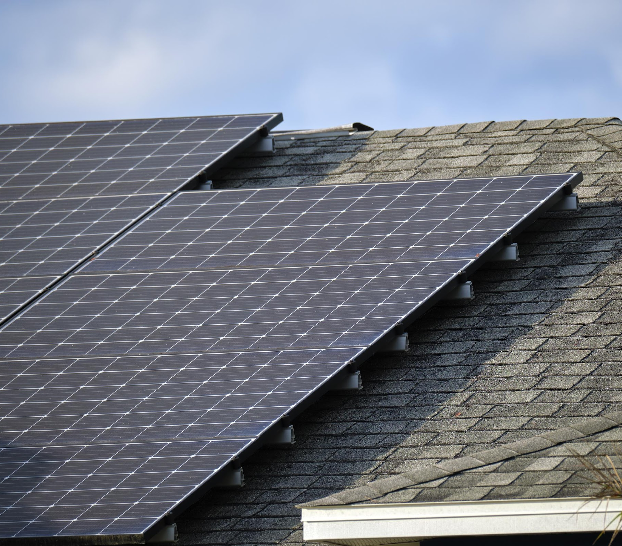
Solar Site Surveys
Professionals will survey a property to evaluate if it’s a good candidate for on-site solar power.
Is there enough unobstructed solar access?
What is the condition of the location’s roof and electrical system?
Will the array require a ground mount?
Courtesy XXXXXX
Lesson 5: Harnessing the Power of the Sun for Our Communities
15
Notes:
If the site is suitable, workers design and install a system that provides some or all of the site’s required electricity, which lowers emissions and energy bills.

Slide 16
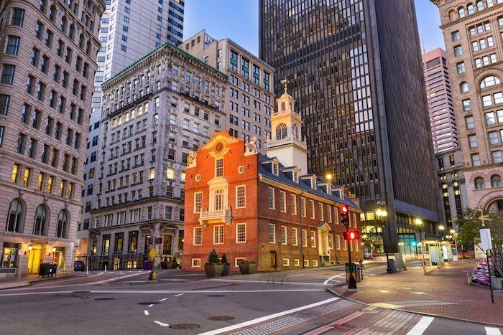
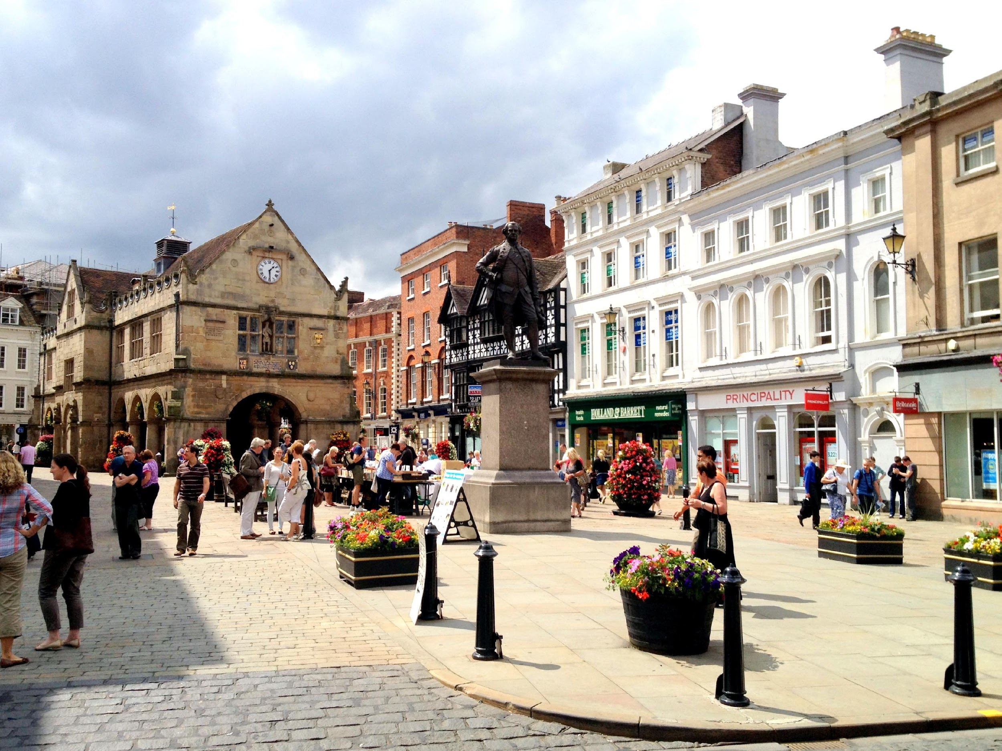
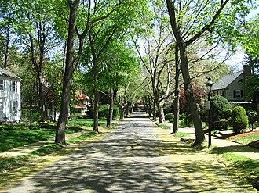
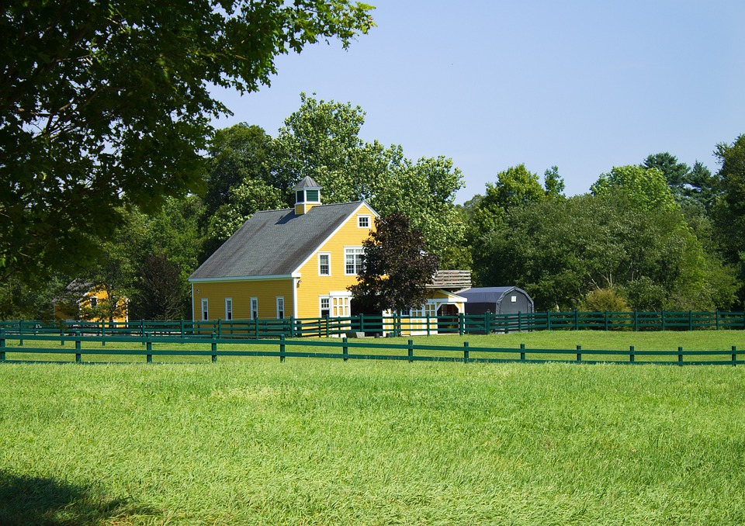
Today’s Group Activity
Create a persuasive pitch for a community solar project in your assigned town!
City Center
Historic District
Suburban Town
Rural Community
This Photo by Unknown Author is licensed under CC BY-SA
Lesson 5: Harnessing the Power of the Sun for Our Communities
Notes:
Activity objective: Allow students to apply what they’ve learned about community solar and think critically about how solar energy projects can be tailored to various communities with unique needs.
Instructions:
Divide students into four groups. Depending on class size, you may decide to assign more than one group to each of the four communities for the activity.
Assign each group to one of the four communities on their worksheets: City Center, Historic District, Suburban Town, Rural Community.
Working together, each group will:
Analyze the details of their community provided on the worksheets. Students will focus on the unique needs and opportunities of their community, including any challenges that must be overcome.
Create a persuasive pitch for a community solar project in their assigned community. Each group will need to consider the characteristics of their community when creating their pitch. Students will use the pitch structure provided in their worksheets: Introduction, Benefits, Challenges, and Call to Action.
Prepare to present their pitch to the class.

Slide 17
Today’s Group Activity
Your pitch should include:
Introduction: Introduce your town and explain why solar energy is vital.
Benefits: Explain the benefits of community solar for your town.
Challenges: Identify two or three key challenges and how to overcome them.
Call to action: Make a persuasive case for why this project should happen now!
Lesson 5: Harnessing the Power of the Sun for Our Communities
17
Notes:
Instructions (same as previous slide):
Divide students into four groups. Depending on class size, you may decide to assign more than one group to each of the four communities for the activity.
Assign each group to one of the four communities on their worksheets: City Center, Historic District, Suburban Town, Rural Community.
Working together, each group will:
Analyze the details of their community provided on the worksheets. Students will focus on the unique needs and opportunities of their community, including any challenges that must be overcome.
Create a persuasive pitch for a community solar project in their assigned community. Each group will need to consider the characteristics of their community when creating their pitch. Students will use the pitch structure provided in their worksheets: Introduction, Benefits, Challenges, and Call to Action.
Prepare to present their pitch to the class.

Slide 18
Group Debrief
Which pitch did you find most compelling? Why?
What challenges do you think are most common with community solar projects?
How could projects like these help address issues of energy equity?
Lesson 5: Harnessing the Power of the Sun for Our Communities
18
Notes:
Guiding questions for closing the discussion:
Which pitch did you find the most compelling, and why?
Encourage students to share what made a particular pitch stand out; was it how they addressed the community’s needs? Creativity? Clarity?
What challenges do you think are most common across different communities when implementing new community solar projects?
Help students along with common barriers such as funding, infrastructure, or community buy-in if necessary.
How could projects like these help address issues of energy equity in underserved communities?

Slide 19
Community solar projects allow multiple participants to share the benefits of a single solar installation, increasing access to renewable energy.
Successful community solar programs prioritize collaboration, location suitability, and community involvement.
Environmental justice ensures that disadvantaged communities gain access to clean energy and its benefits.
Lesson 5: Harnessing the Power of the Sun for Our Communities

Slide 20
Closing Activity
Answer one of these questions:
How can community solar projects positively impact Massachusetts’s climate goals?
How can community solar address energy equity in your community?
Lesson 5: Harnessing the Power of the Sun for Our Communities
20
Notes:
Give students 30–60 seconds to consider their reflections.
Call on students one by one, and invite them to respond to one of these reflection questions. They may respond to both if they wish, but they only need to respond to one.

Slide 21
Community solar creates greater access to the benefits of clean, renewable solar energy.

